Slide 1


Zero Trust Infrastructure Utilizing Network Segmentation and Microservices in a Financial System
By: Shanysse Alexander

Slide 2

Table Of Contents
Introduction
Problem Statement
Literature Review
Methods 1-8
Most Effective Method
Conclusion

Slide 3

Introduction
Zero Trust emphasizes the need for continuous authentication and strict access controls, requiring verification at every access point.
This model is useful for financial systems where data integrity is imperative.
Implementing Zero Trust involves a comprehensive approach that incorporates network segmentation and microservices to enhance security and minimize vulnerabilities.

Slide 4

Problem Statement
As cyberattacks grow and become more sophisticated, traditional security measures are not as effective particularly for financial institutions.
Financial institutions handle sensitive data that is a prime target for threat actors because a common driver of hacking is money.

Slide 5
Literature Review
The articles in this paper includes the following methods which are the Kubernetes (Zero Trust Model), Network Segmentation, Multi-Factor Authentication (MFA), and Role-Based Access Control (RBAC).
Kubernetes is a container technology
Network Segmentation which uses VLANs to create separation on the network which can help isolate sensitive financial systems.
Multi-Factor Authentication method which requires all users to prove their identity before being able to access sensitive systems.
Role-Based Access Control (RBAC) which involves ensuring that users can only access the data and applications for their specific roles.

Slide 6
Kubernetes (Zero Trust Model)
To combat these risks, a Zero Trust model is employed at the network level, which emphasizes strict access controls and continuous verification of all users and devices within the network.
This approach helps mitigate the threats of internal and external attacks, ultimately protecting a financial institution from disruptions.

Slide 7
Multi-Factor Authentication
MFA can be used to provide stronger remote authentication.
Multifactor authentication (MFA) adds extra layers of security by requiring users to provide two or more verification factors to access a system, making it more reliable than single-factor methods like passwords.

Slide 8
Network Segmentation
Network segmentation is vital in the design of networks as it implements the separation of concerns principle by putting resources with “similar” policies under the same firewall
This separation helps limit the damage of an attack because if an attacker is successful, they would only be affecting a portion of the network

Slide 9
Role-Based Access Control (RBAC)
RBAC allows for flexible management of user permissions based on their roles within the organization.
The use of RBAC can assign basic access rights to the users such as allowing tellers to access customer account data.

Slide 10
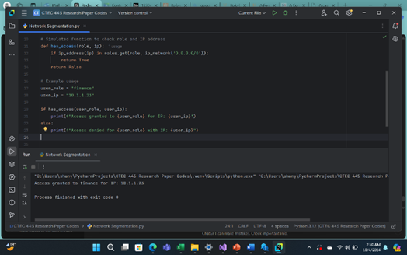
Network Segmentation using RBAC and IP Filtering
In this code the snippet implements a simple access control mechanism based on user roles and their allowed network ranges using the `ipaddress` module.
It defines a dictionary where each user role, such as "admin," "finance," and "general," is connected to a specific IP address range, allowing access only from specific subnets.

Slide 11
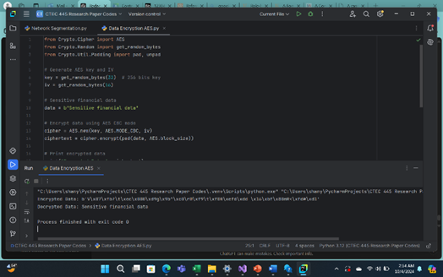
Data Encryption using AES
This code shows the encryption and decryption of sensitive financial data using the Advanced Encryption Standard (AES) in Cipher Block Chaining (CBC) mode.

Slide 12
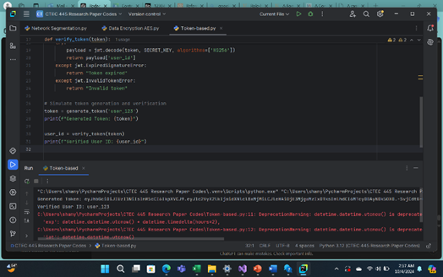
Token-based Authentication for Microservices
This code simulates the creation and verification of JSON Web Tokens (JWT) for user authentication in a financial system.
It defines a secret key for signing the tokens and a function to generate a JWT that includes the user's ID, along with expiration and issued-at timestamps.

Slide 13
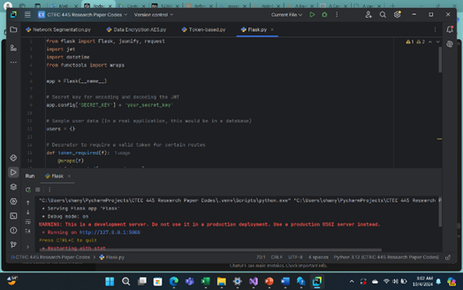
Token-Based Authentication Using Flask and JWT
In this code Flask application provides a simple API for user registration, login, and token-protected access to certain routes.
Users can register by giving the system their username and password, which will be stored in the memory.

Slide 14
Most Effective Methodology
Multi-Factor Authentication (MFA) is one of the best methods to enhance security because it adds additional layers of verification beyond just a password, making it significantly harder for attackers to gain unauthorized access.

Slide 15
References
[1] Abhishek, K., Roshan, S., Kumar, P., & Ranjan, R. (2012). A comprehensive study on multifactor authentication schemes. In Advances in intelligent systems and computing (pp. 561–568). https://doi.org/10.1007/978-3-642-31552-7_57
[2] Mhaskar, N., Alabbad, M., & Khedri, R. (2021). A formal approach to network segmentation. Computers & Security, 103, 102162. https://doi.org/10.1016/j.cose.2020.102162
[3] Sandhu, R. S. (1998). Role-based access control. In Advances in computers (pp. 237–286). https://doi.org/10.1016/s0065-2458(08)60206-5
[4] Surantha, N., Ivan, F., & Chandra, R. (2023, October 1). A case analysis for Kubernetes network security of financial service industry in Indonesia using zero trust model. Surantha | Bulletin of Electrical Engineering and Informatics. https://beei.org/index.php/EEI/article/view/4240/3427

